Slide 1

Introduction to Database
Lecture 1 (Part 1)
UECS 1203
DATABASE SYSTEM FUNDAMENTALS

Slide 2
Introduction
Mr. Sugumaran Nallusamy
sugumaran@utar.edu.my
Textbook: Database Solutions, 6th Edition
Thomas Conolly & Carolyn Begg

Slide 3
Course Assessments
6 Components:
Practical Assignment 1 10%
Practical Assignment 2 10%
Practical Assignment 3 10%
Quiz 5%
Midterm Test 15%
Final Exam 50%

Slide 4
Practical Lab (10 Weeks)
Start on Week 2
Oracle Database 11g Release 2
(Link : https://www.dropbox.com/s/qr4hj35rzxztvtq/Oracle%2011g%2032%20bit%20Setup%20Files%20New.zip?dl=0)
Practical Notes zipped and available in WBLE
(practical.zip)

Slide 5
In this chapter, you will learn:
The difference between data and information
What a database is, about different types of databases, and why they are valuable assets for decision making
How modern databases evolved from files and file systems

Slide 6
In this chapter, you will learn (continued):
Flaws in file system data management
How a database system differs from a file system
DBMS Architectures
How a DBMS functions within the database system

Slide 7
In this chapter, you will learn (continued):
Common uses of database systems.
Meaning of the term database.
Meaning of the term Database Management System (DBMS).
Components of the DBMS environment.
Typical functions of a DBMS.
Advantages/disadvantages of DBMSs.

Slide 8
What is Database?

Slide 9
Examples of Database Systems
Purchases from the supermarket
Purchases using your credit card
Booking a holiday at the travel agents
Using the local library
Renting a video
Using the Internet

Slide 10
Data vs. Information
Data:
  Raw facts; building blocks of information
  Unprocessed information
Information:
  Data processed to reveal meaning
Accurate, relevant, and timely information is key to good decision making
Good decision making is key to survival in global environment
Notes:
Data
Raw facts
Observations
Not processed (yet)
Not meaningful to the audience/reader
Information
Processed data
Summarized
Organized
Labeled
Meaningful to audience

Slide 11
Data vs. Information
Data becomes information when shown in context to reference values (limits, past information, correlated data, what’s expected, etc.)
What is 800? Is it good or bad?
Depends on the limits, and the scale, and our goals.

Slide 12
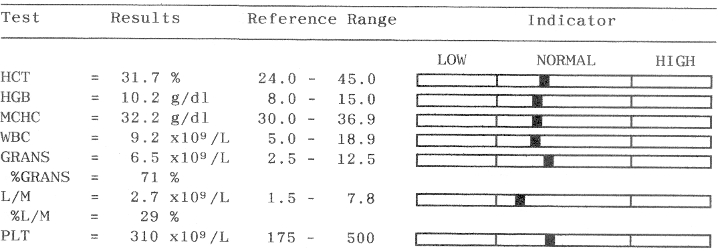
My cat’s blood work results: Good or bad?

Slide 13
And now?

Slide 14
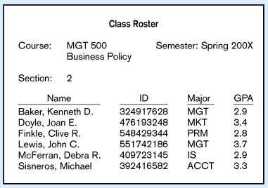
Context helps users understand data

Slide 15
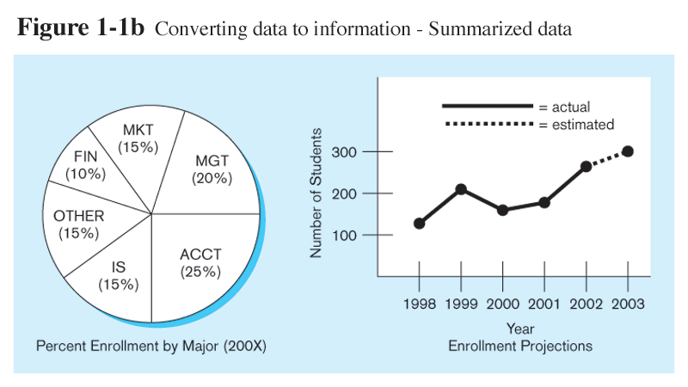
Graphical displays turn data into useful information that managers can use for decision making and interpretation

Slide 16
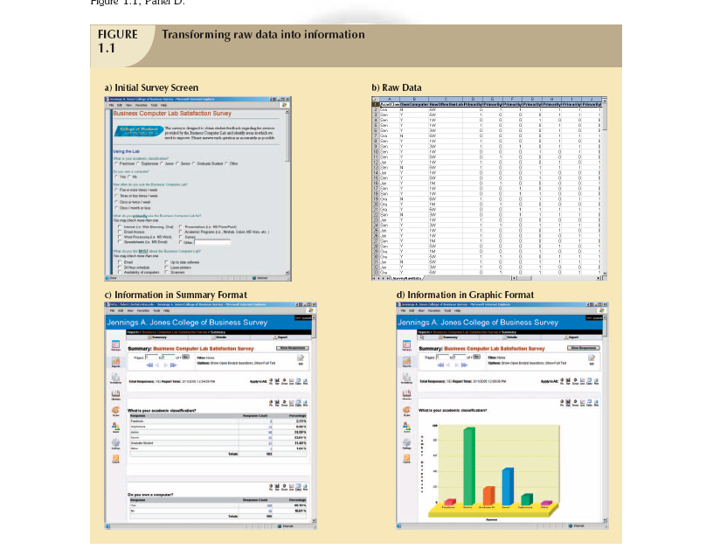

Slide 17
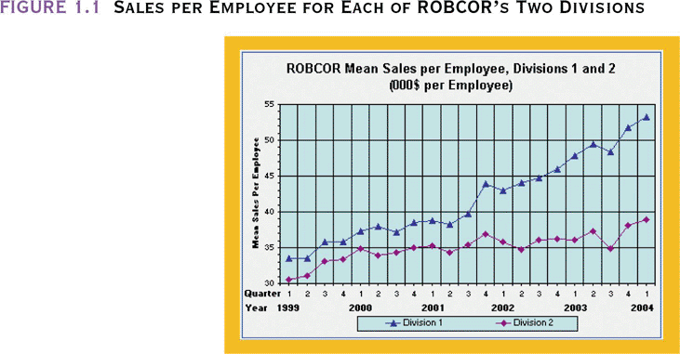

Slide 18
Evolution of DB Systems
1st Generation
Flat files - 1960s - 1980s
Hierarchical – 1970s - 1990s
Network – 1970s - 1990s
Relational – 1980s - present
Object-oriented – 1990s - present
Object-relational – 1990s - present
Data warehousing – 1980s - present
Web-enabled – 1990s - present
2nd Generation
3rd Generation
4th Generation
Notes:
The first generation supported sequential and random searching, but the user was required to write a computer program to obtain access.
The second generation products were the first true DBMSs as they could manage multiple entity types and relationships. However, to obtain access to data, a computer program still had to be written. Second generation systems are referred to as “navigational” because the programmer had to write code to navigate among a network of linked records.
Third generation systems are known as relational DBMSs because of the foundation based on mathematical relations and associated operators. Optimization technology was developed so that access using non-procedural languages would be efficient.
Fourth generation systems can store and manipulate unconventional data types such as images, videos, maps, sounds, and animations. Because these systems view any kind of data as an object to manage, fourth generation systems are sometimes called “object-oriented” or “object-relational”. In addition to the emphasis on objects, the Internet is pushing DBMSs to develop new forms of distributed processing.

Slide 19
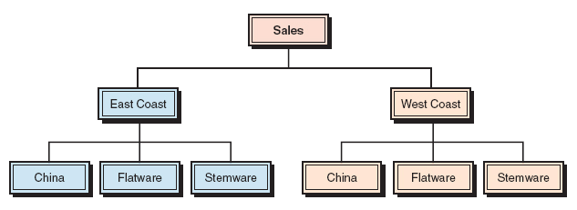
Hierarchical DBMS
Organizes data in a tree-like structure
Supports one-to-many parent-child relationships
Prevalent in large legacy systems

Slide 20
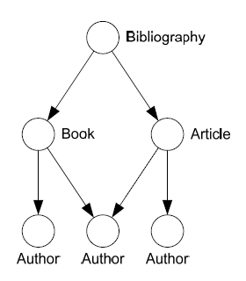
Network Databases
Data organised in graph (lattice)
  A parent can have many children.
  A child can have many parents
Bachmann diagrams
Records types defines properties
Set types defined relationships
  Parent-child, (double) linked List,…
Query by graph navigation
Examples
  CODASYL

Slide 21
The Historical Roots of Database:
Files and File Systems
Although managing data through file systems is largely obsolete
  Understanding relatively simple characteristics of file systems makes complexity of database design easier to understand
  Awareness of problems that plagued file systems can help prevent similar problems in DBMS
  Knowledge of file systems is helpful if you plan to convert an obsolete file system to a DBMS
Notes:
x

Slide 22
Manual File Systems
Traditionally composed of collection of file folders kept in file cabinet
Organization within folders was based on data’s expected use (ideally logically related)
System was adequate for small amounts of data with few reporting requirements
Finding and using data in growing collections of file folders became time-consuming and cumbersome

Slide 23
Conversion from Manual File System to Computer File System
Could be technically complex, requiring hiring of data processing (DP) specialists
DP specialists created file structures, wrote software, and designed application programs
Resulted in numerous “home-grown” systems being created
Initially, computer files were similar in design to manual files (see Figure 1.3)

Slide 24
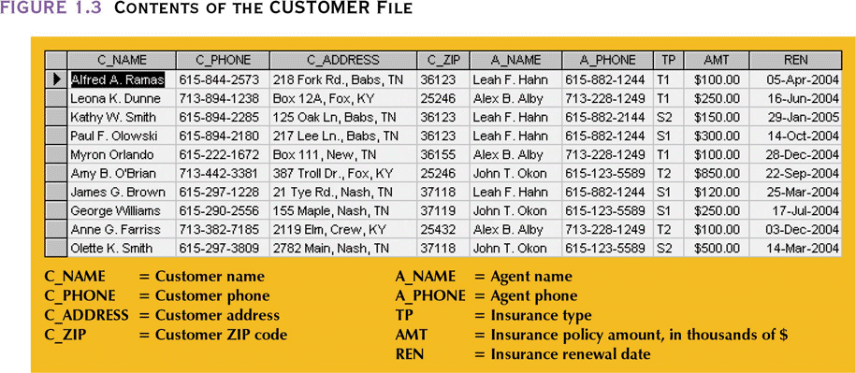

Slide 25
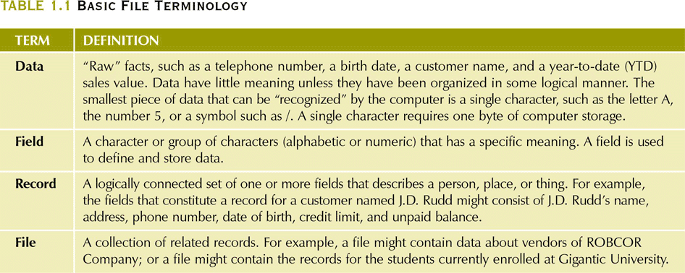

Slide 26
Example of Early Computer File System
DP specialist wrote programs for reports:
  Monthly summaries of types and amounts of insurance sold by agents
  Monthly reports about which customers should be contacted for renewal
  Reports that analyzed ratios of insurance types sold by agent
  Customer contact letters summarizing coverage
Additional reports were written as required

Slide 27
Example of Early Computer File System (continued)
Other departments requested databases be written for them
  SALES database created for sales department
  AGENT database created for personnel department
Notes:
x

Slide 28
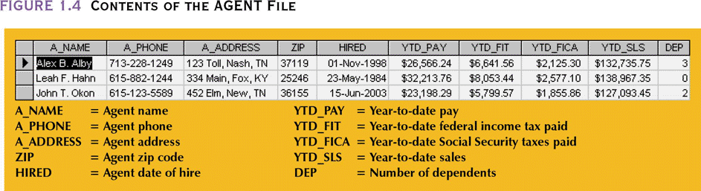
Notes:
x

Slide 29
File-based Systems
Collection of application programs that perform services for the end users (e.g. reports).
Each program defines and manages its own data.

Slide 30
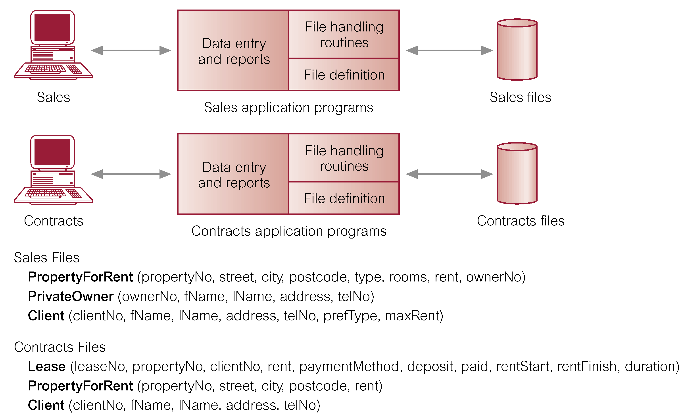
Notes:
Clearly that there is a significant amount of duplication of data in these dept.

Slide 31
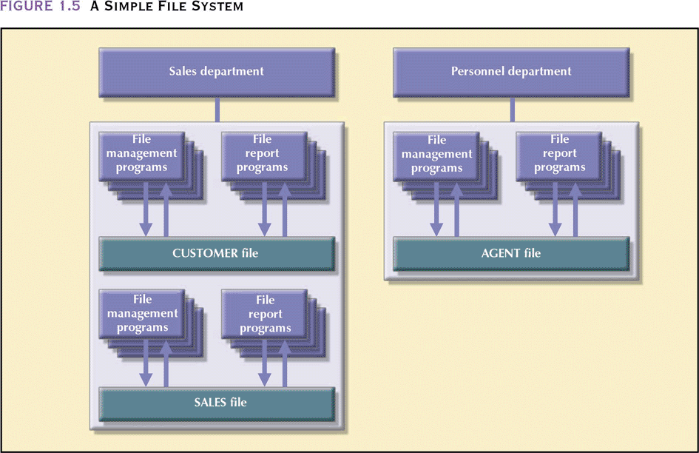

Slide 32
Limitations of File-based Approach
Separation and isolation of data
  Each program maintains its own set of data.
  Users of one program may be unaware of potentially useful data held by other programs.
Duplication of data
  Same data is held by different programs.
  Wasted space and potentially different values and/or different formats for the same item.
  results in data inconsistency

Slide 33
Limitations of File-based Approach
Data dependence
  File structure is defined in the program code.
  All programs maintain metadata for each file they use
Incompatible file formats
  Programs are written in different languages, and so cannot easily access each others files.
Fixed Queries/Proliferation of application programs
  Programs are written to satisfy particular functions. Any new requirement needs a new program.
  Excessive Program Maintenance

Slide 34
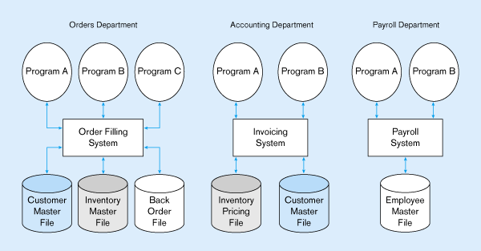
Figure 1-2 Three file processing systems at Pine Valley Furniture
Duplicate Data

Slide 35
SOLUTION: The DATABASE Approach
Central repository of shared data
Data is managed by a controlling agent
Stored in a standardized, convenient form
Notes:
A shared collection of logically related data and a description of this data, designed to meet the information need of an organization.

Slide 36
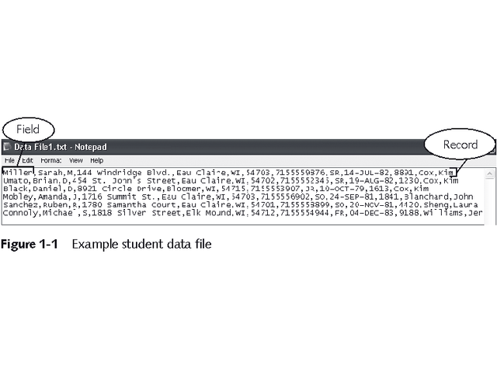
Before Databases
Information was kept in files:
  Each field describes one piece of information about student
  Fields are separated by commas
  A record is a collection of related fields
  Each record is a separate line

Slide 37
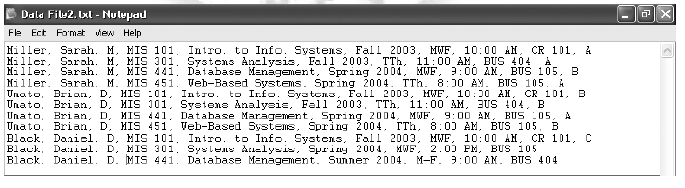
Redundant data and inconsistent data stored in files

Slide 38
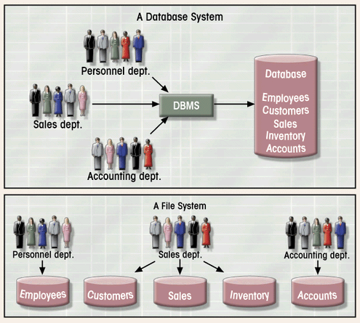
Contrasting Database and File Systems

Slide 39
Database
A shared collection of logically related data and a description of this data, designed to meet the information need of an organization.
Notes:
All data items are integrated with a minimum amount of duplication.

Slide 40
Database Characteristics
Persistent
  - Lasts a long time
  - Relevance of intended usage: only store potentially relevant data
Inter-related
  - Entity: cluster of data about a topic (course, student, loan)
  - Relationship: connection among entities
Shared
  - Multiple uses: hundreds to thousands of data entry screens and reports
  - Multiple users: many people simultaneously use a database
Notes:
Database is a generic term; collection of data
Databases are ubiquitous; many encounters this week
Persistent:
- Lasts a long time (not transient)
- Lasts longer than the execution of a computer program
- Program variables are not stored in a database
- Relevance of intended usage: only store potentially relevant data
Inter-related:
- Entity: cluster of data about a topic (customer, student, loan)
- Relationship: connection among entities
Shared:
- Multiple uses: hundreds to thousands of data entry screens and reports
- Multiple users: many people simultaneously use a database

Slide 41
Database Characteristics
Description of the data – the system catalog (meta-data) provides description of data to enable data independence.

Slide 42
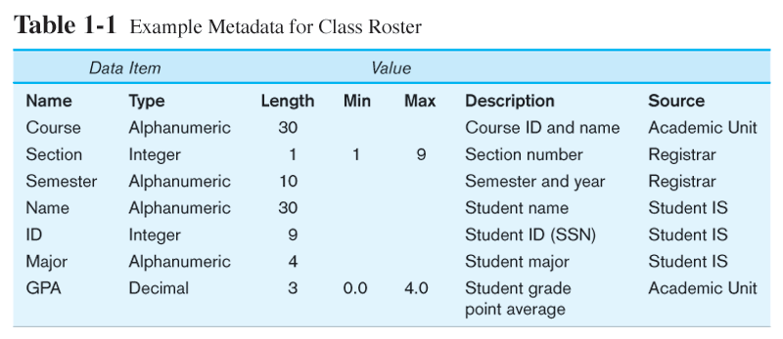
Descriptions of the properties or characteristics of the data, including data types, field sizes, allowable values, and data context

Slide 43
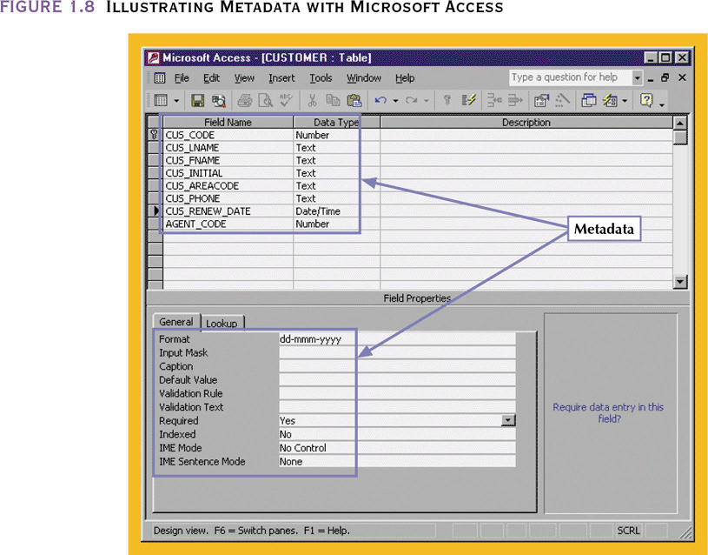
Illustrating Metadata with Microsoft Access

Slide 44
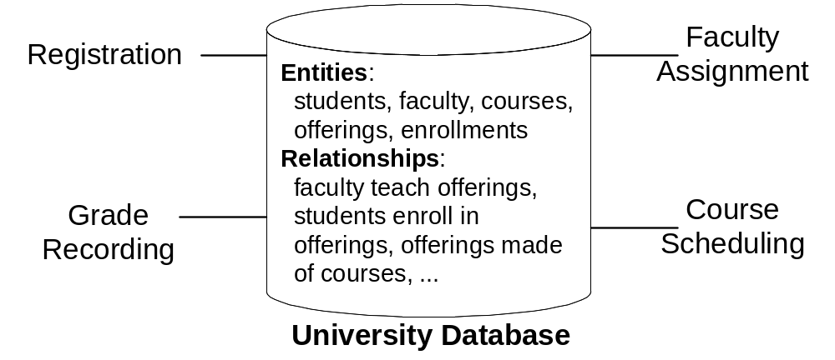
University Database

Slide 45
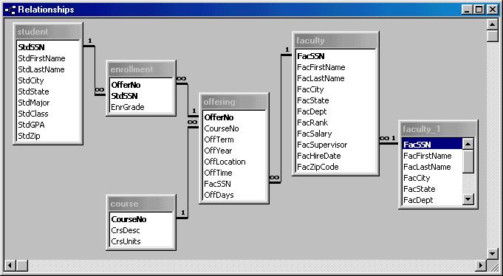
University Database

Slide 46
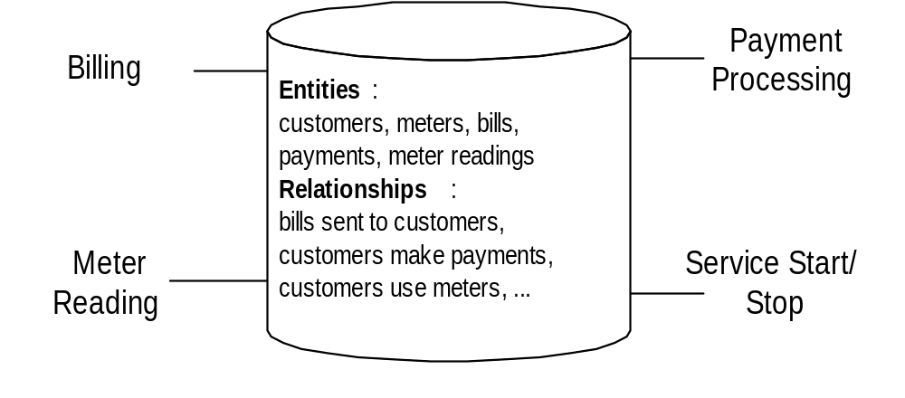
Water Utility Database

Slide 47
Examples of Database Systems ??

Slide 48
Database Applications
  Banking: all transactions
  Airlines: reservations, schedules
  Universities: registration, grades
  Sales: customers, products, purchases
  Manufacturing: production, inventory, orders, supply chain
  Human resources: employee records, salaries, tax deductions

Slide 49
Uses of Databases
Transactional (or production):
  Supports day-to-day operations
Data warehouse:
  Stores data used to generate information required to make tactical or strategic decisions
    “data massaging”
  Often used to store historical data
  Structure is quite different

Slide 50
Types of Databases
Single-user/Desktop:
  Supports only one user at a time
Multi-user:
  Supports multiple users at the same time

Slide 51
Types of Databases (continued)
Workgroup:
  Multi-user database that supports a small group of users or a single department
Enterprise:
  Multi-user database that supports a large group of users or an entire organization

Slide 52
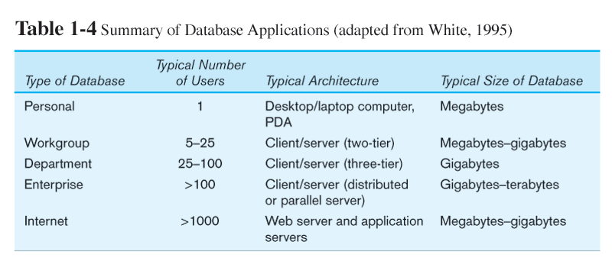

Slide 53
Location of Databases
Centralized:
  Supports data located at a single site
Distributed:
  Supports data distributed across several sites
  Connected through network

Slide 54
Database Systems

Slide 55
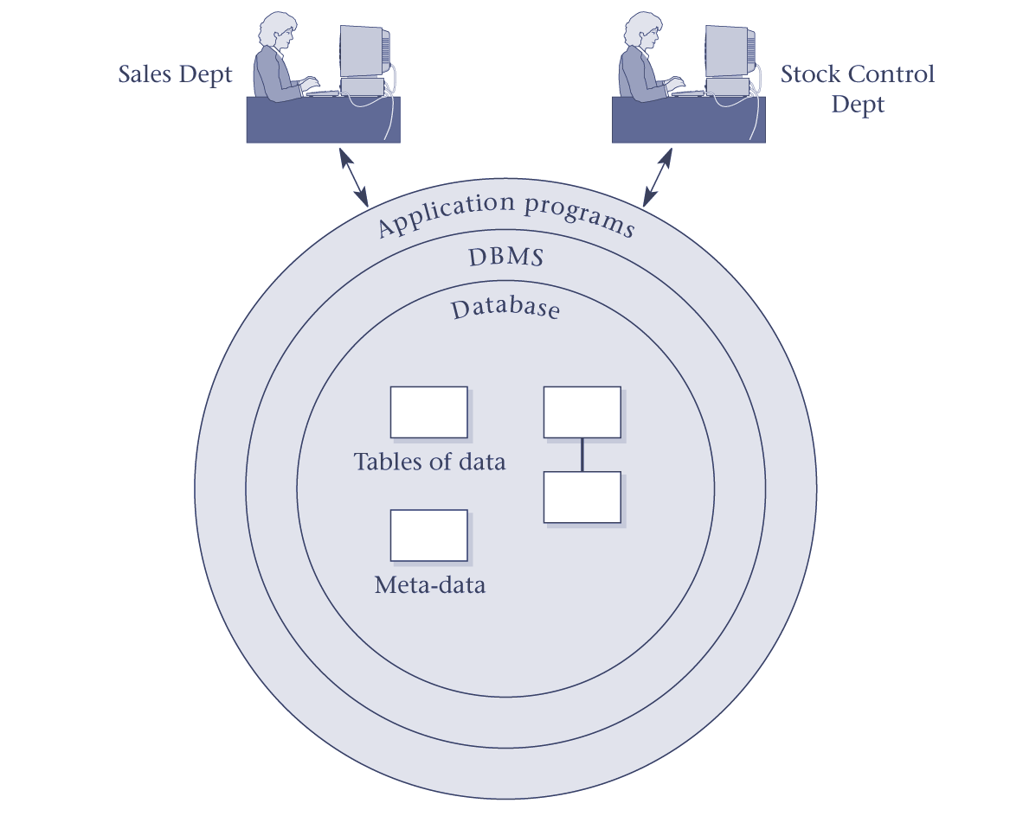
DBMS

Slide 56
DBMS
A software system that enables users to define, create, and maintain the database and that provides controlled access to this database.

Slide 57
Introducing the Database and the DBMS
DBMS (database management system):
  Collection of programs that manages database structure and controls access to data
  Possible to share data among multiple applications or users
  Makes data management more efficient and effective
Notes:
A software system that enables users to define, create, maintain and control access to the database. DBMS is a collection of components that supports the creation, use and maintenance of database.
Provide efficient storing and retrieval of data. Data acquisition, storage, dissemination, maintenance, retrieval and formatting.

Slide 58
Components of DBMS Environment
Hardware
  Can range from a PC to a network of computers.
Software
  DBMS, operating system, network software (if necessary) and also the application programs.
Data
  Used by the organization and a description of this data called the schema.

Slide 59
Components of DBMS Environment
Procedures
  Instructions and rules that should be applied to the design and use of the database and DBMS.
People
  Includes database designers, DBAs, application programmers, and end-users.

Slide 60
People (roles) in database environment
Functional users
  Indirect, parametric, power
Information system users
  DBA, Analyst/Programmer/Management
Notes:
Because databases are pervasive, there are a variety of ways in which you may interact with databases. The classification distinguishes between functional users who interact with databases as part of their work and information systems professionals who participate in designing and implementing databases. You may simultaneously play more than one role.

Slide 61
Database Specialists
Database administrator (DBA)
  More technical
  DBMS specific skills
Data administrator
  Less technical
  Planning role
Notes:
DBA:
- focused on individual databases and DBMSs
- Need strong skills in specific DBMSs
Data administrator
- Planning: databases and technology
- Standards setting
- Computerized and non-computerized databases
Large organizations have separate positions; small organizations combine roles
Both positions require more than 1 db course
- 2nd course
- certification
- lots of experience
- management experience for data administration

Slide 62
DBMS Functions
Performs functions that guarantee integrity and consistency of data
  Data dictionary management
    defines data elements and their relationships
  Data storage management
    stores data and related data entry forms, report definitions, etc.
  Data transformation and presentation
    translates logical requests into commands to physically locate and retrieve the requested data

Slide 63
DBMS Functions (continued)
  Security management
    enforces user security and data privacy within database
  Transaction support
    Ensure that all the updates corresponding to a given transaction are made or none of them are made.
  Multi-user access control
    creates structures that allow multiple users to access the data
  Backup and recovery management
    provides backup and data recovery procedures
Notes:
Security management –authorization service
Data is the biggest asset of a company.
Protect some of the data from being seen by all users. Only manager and payroll can see the salary related information for staff.
Protect database against unauthorized access
Transaction support
In the middle of transaction, system crash, database in inconsistent state (some changes made and others not) then the changes made will b undone and bring the database back to the consistent state.
Multi-user access control – concurrency control service
-one of the objective of db is to enable many users to access shared data concurrently. if user only read, then no way that they can interfere with one another. However, if two or more user are accessing the database simultaneously, and one of them is updating the data, then there may cause inconsistencies.
Backup and recovery management
when discussing transaction support, we mentioned tat if the transaction fails. The database has to return to a consistent state. This is known as recovery control.

Slide 64
DBMS Functions (continued)
  Data integrity management
    promotes and enforces integrity rules to eliminate data integrity problems
  Data query language
    Lets user specify what must be done without having to specify how it is to be done.
  Database communication interfaces
    allows database to accept end-user requests within a computer network environment

Slide 65
DBMS Makes Data Management More Efficient and Effective
End users have better access to more and better-managed data
  Promotes integrated view of organization’s operations
  Probability of data inconsistency is greatly reduced
  Possible to produce quick answers to ad hoc queries

Slide 66
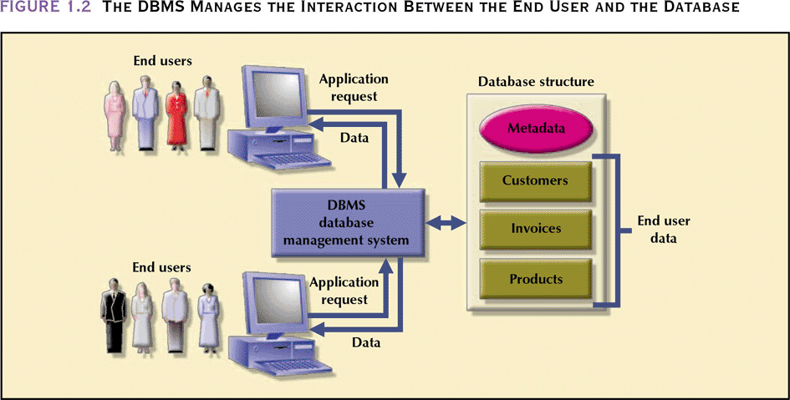
The DBMS Manages the Interaction Between the End User and the Database

Slide 67
DBMS Architectures
Generally a DBMS is divided into two parts:
Client – program that handles the main business and data processing logic and interfaces with the user;
Server – program that manages and control access to the database
~~ two-tier architecture/ client-server architecture
Notes:
Business logic and data processing is inside the client – increase overhead

Slide 68
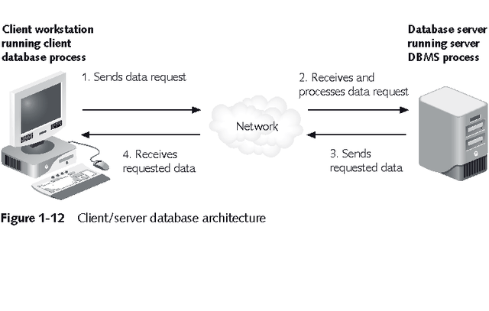
Client/Server Database Architecture

Slide 69
New variation of DBMS Architectures
Three-tier architecture
  Client (User interface layer)
  Application server (Business logic and data processing layer)
  Database server (DBMS)

Slide 70
Advantages over the traditional two tier design.
Thin client
Simplified application maintenance.
Added modularity
Easier load balancing

Slide 71
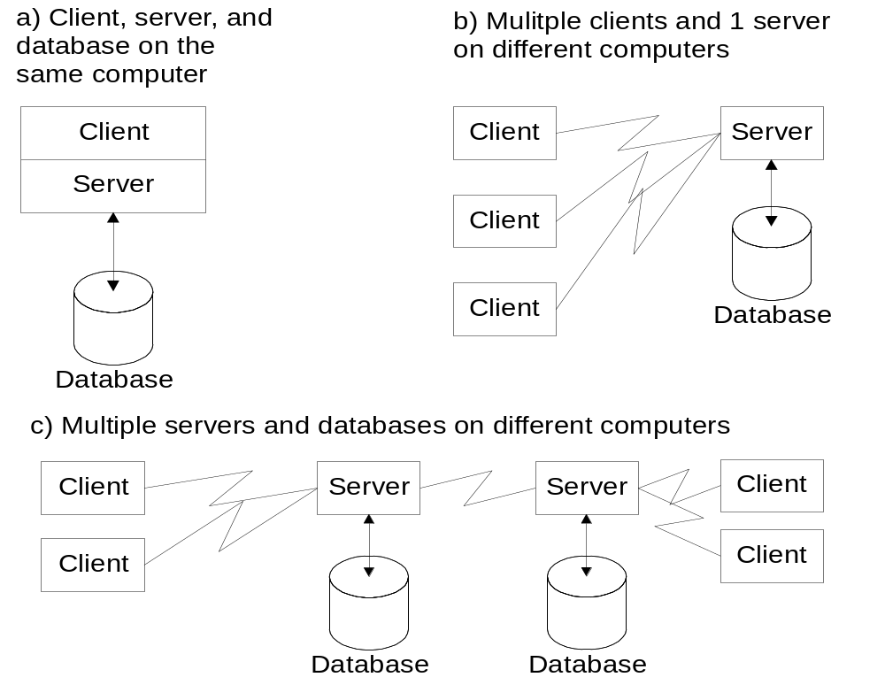
Client-Server Architecture
Notes:
Client-Server Architecture: an arrangement of components (clients and servers) and data among computers connected by a network. The client-server architecture supports efficient processing of messages (requests for service) between clients and servers.
To improve performance and availability of data, the client-server architecture supports many ways to distribute software and data in a computer network. The simplest scheme is just to place both software and data on the same computer (Figure 13(a)). To take advantage of a network, both software and data can be distributed. In Figure 13(b), the server software and database are located on a remote computer. In Figure 13(c), the server software and database are located on multiple remote computers.

